Slide 1
Functional and Nonfunctional Requirements: Specification and Types
Dr. V. Arulkumar
Asst.Prof, IT

Slide 2
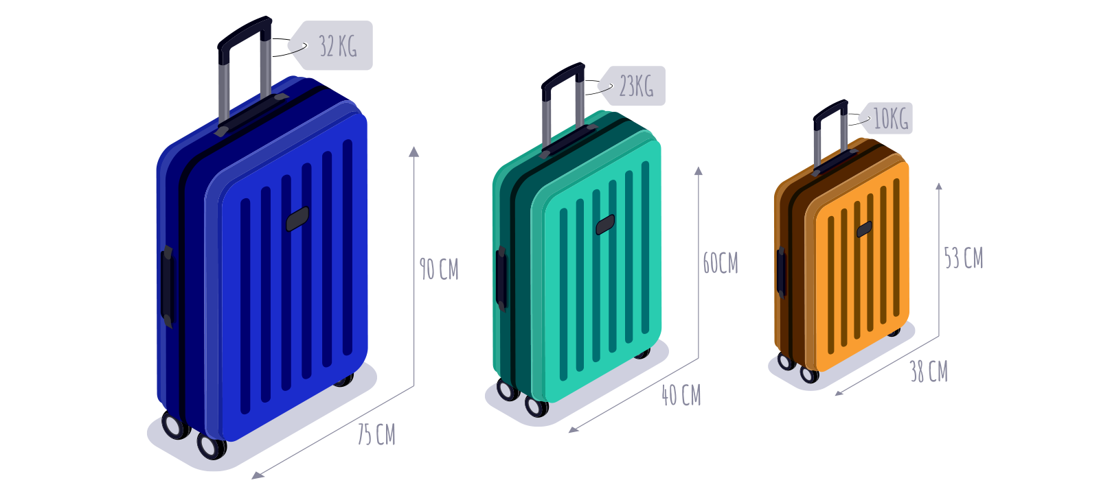
Travel Suitcase

Slide 3
requirements are essential signs on the road that leads to a successful project.
They establish a formal agreement between a client and a provider that they are both working to reach the same goal.
High-quality, detailed requirements also help mitigate financial risks and keep the project on a schedule.
According to the Business Analysis Body of Knowledge (BABOK) definition, requirements are a usable representation of a need.
Creating requirements is a complex task as it includes a set of processes such as elicitation, analysis, specification, validation, and management.

Slide 4
Types of requirements
Business requirements
increased revenue/throughput/customer reach,
reduced expenses/errors,
improved customer service, etc.
User (stakeholder) requirements
The needs of discrete stakeholder groups (top-level managers, nonmanagement staff, customers, etc.) are specified to define what they expect from a particular solution.
Solution requirements
  Functional requirements define what a product must do, what its features and functions are.
  Nonfunctional requirements describe the general properties of a system. They are also known as quality attributes.

Slide 5
  Transition requirements
An additional group of requirements defines what is needed from an organization to successfully move from its current state to its desired state with the new product.
They are only necessary for the short period of time while the transition takes place. Examples can be “users must be trained to operate the system” or “previous data must be migrated to the cloud storage.”

Slide 6
Functional vs nonfunctional requirements
Functional requirements are product features or functions that developers must implement to enable users to accomplish their tasks. So, it’s important to make them clear both for the development team and the stakeholders.
Generally, functional requirements describe system behavior under specific conditions.
For example:
The system sends an approval request after the user enters personal information.
A search feature allows a user to hunt among various invoices if they want to credit an issued invoice.
The system sends a confirmation email when a new user account is created.

Slide 7
Nonfunctional requirements, not related to the system functionality, rather define how the system should perform.
Some examples are:
The website pages should load in 3 seconds with the total number of simultaneous users <5 thousand.
The system should be able to handle 20 million users without performance deterioration.

Slide 8
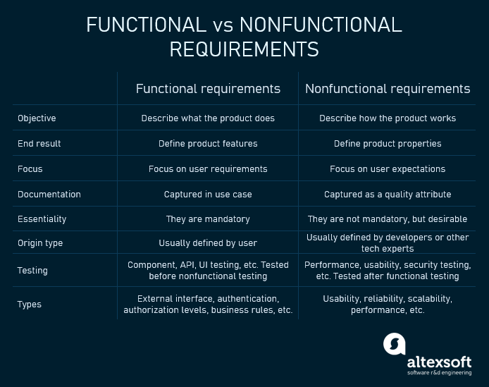

Slide 9
Types of functional requirements and their specifications
Functional requirements can be classified according to different criteria.
For example, we can group them on the basis of the functions a given feature must perform in the end product.
They would differ depending on the product being developed,
The types of functional requirements might be
Authentication
Authorization levels
Compliance to laws or regulations
External interfaces
Transactions processing
Reporting
Business rules, etc.

Slide 10
Requirements are usually written in text, However, they may also be visuals. Here are the most common formats and documents:
Software requirements specification document
Use cases
User stories
Work Breakdown Structure (WBS), or functional decomposition
Prototypes
Models and diagrams

Slide 11
Software requirements specification document
Both functional and nonfunctional requirements can be formalized in the software requirements specification (SRS) document.
The SRS contains descriptions of functions and capabilities that the product must provide. The document also defines constraints and assumptions.
The SRS can be a single document communicating functional requirements or it may accompany other software documentation like user stories and use cases.
Experts don’t recommend composing SRS for the entire solution before the development kick-off, but you should document the requirements for every single feature before actually building it.
Once you receive the initial user feedback, you can update the document.

Slide 12
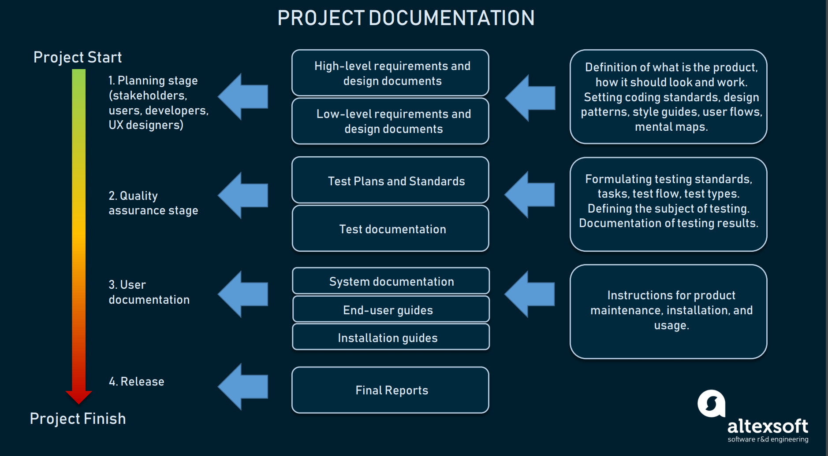
Project Documentation – A glance

Slide 13
SRS
SRS must include the following sections:
Purpose. Definitions, system overview, and background.
Overall description. Assumptions, constraints, business rules, and product vision.
Specific requirements. System attributes, functional requirements, and database requirements.

Slide 14
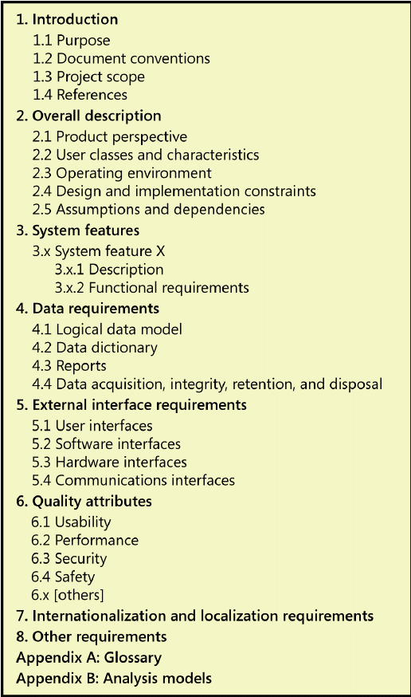
Sample SRS

Slide 15
Use cases
Use cases describe the interaction between the system and external users that leads to achieving particular goals.
Each use case includes three main elements:
Actors. These are the external users that interact with the system.
System. The system is described by functional requirements that define an intended behavior of the product.
Goals. The purposes of the interaction between the users and the system are outlined as goals.
There are two formats to represent use cases:
  Use case specification structured in textual format
  Use case diagram

Slide 16
A use case specification represents the sequence of events along with other information that relates to this use case. A typical use case specification template includes the following information:
Description
Pre- and Post- interaction condition
Basic interaction path
Alternative path
Exception path

Slide 17
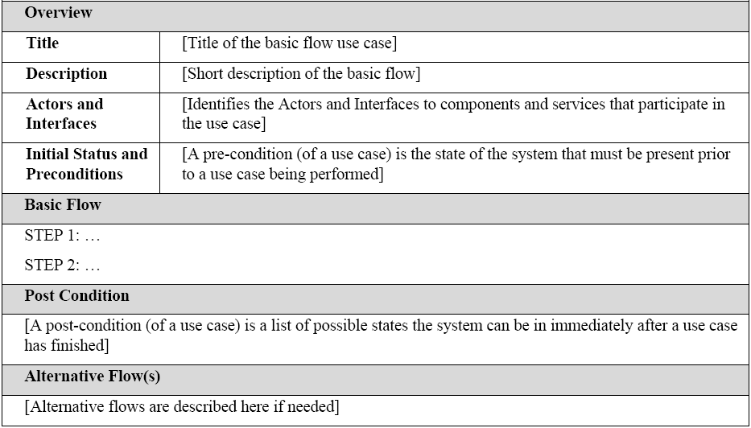
Example:
A use case diagram doesn’t contain a lot of details. It shows a high-level overview of the relationships between actors, different use cases, and the system.

Slide 18
The use case diagram includes the following main elements:
Use cases. Usually drawn with ovals, use cases represent different interaction scenarios that actors might have with the system (log in, make a purchase, view items, etc.).
System boundaries. Boundaries are outlined by the box that groups various use cases in a system.
Actors. These are the figures that depict external users (people or systems) that interact with the system.
Associations. Associations are drawn with lines showing different types of relationships between actors and use cases.

Slide 19
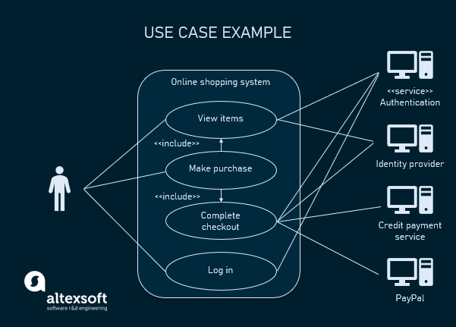

Slide 20
User Stories
A user story is a documented description of a software feature seen from the end-user perspective. The user story describes what exactly the user wants the system to do. In Agile projects, user stories are organized in a backlog, which is an ordered list of product functions. Currently, user stories are considered to be the best format for backlog items.
A typical user story is written like this:
As a <type of user>, I want <some goal> so that <some reason>.

Slide 21
Example:
User stories must be accompanied by acceptance criteria. These are the conditions that the product must satisfy to be accepted by a user, stakeholders, or a product owner.
Each user story must have at least one acceptance criterion. Effective acceptance criteria must be testable, concise, and completely understood by all team members and stakeholders.
They can be written as checklists, plain text, or by using Given/When/Then format.

Slide 22
Example:
Here’s an example of the acceptance criteria checklist for a user story describing a search feature:
A search field is available on the top-bar.
A search is started when the user clicks Submit.
The default placeholder is a grey text Type the name.
The placeholder disappears when the user starts typing.
The search language is English.
The user can type no more than 200 symbols.
It doesn’t support special symbols. If the user has typed a special symbol in the search input, it displays the warning message: Search input cannot contain special symbols.

Slide 23
Finally, all user stories must fit the INVEST quality model:
I – Independent | This means that you can schedule and implement each user story separately. This is very helpful if you implement continuous integration processes.
N – Negotiable | This means that all parties agree to prioritize negotiations over specification. This also means that details will be created constantly during development.
V – Valuable | A story must be valuable to the customer. You should ask yourself from the customer’s perspective “why” you need to implement a given feature.
E – Estimable | A quality user story can be estimated. This will help a team schedule and prioritize the implementation. The bigger the story is, the harder it is to estimate it.
S – Small | Good user stories tend to be small enough to plan for short production releases. Small stories allow for more specific estimates.
T – Testable | If a story can be tested, it’s clear enough and good enough. Tested stories mean that requirements are done and ready for use.

Slide 24
Functional decomposition or Work Breakdown Structures (WBS)
A functional decomposition or WBS is a visual document that illustrates how complex processes break down into their simpler components.
WBS is an effective approach to allow for an independent analysis of each part. WBS also helps capture the full picture of the project.
Experts suggest the following logic of functional decomposition:
Find the most general function.
Find the closest sub function.
Find the next level of sub function.
Check your diagram.

Slide 25
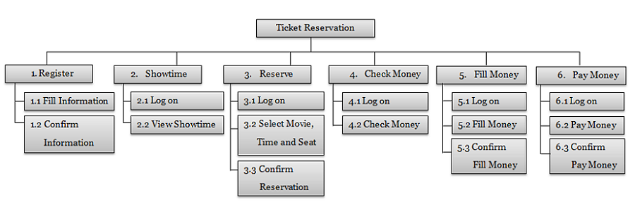
decomposition process may look like this:
High Level Function ->Sub-function -> Process -> Activity
The features should be decomposed to the point at which the lowest level parts can’t be broken down any further.

Slide 26
Software prototypes
Software prototype is an umbrella term for different forms of early stage deliverables that are built to showcase how requirements must be implemented.
Prototypes help bridge the vision gaps and let stakeholders and teams clarify complicated areas of products in development.
Traditionally, prototypes represent how the solution will work and give examples of how users will interact with it to accomplish their tasks.
Prototypes can be cheap and fast visual representations of requirements (throwaway prototypes) or more complex ones (evolutionary prototypes).

Slide 27
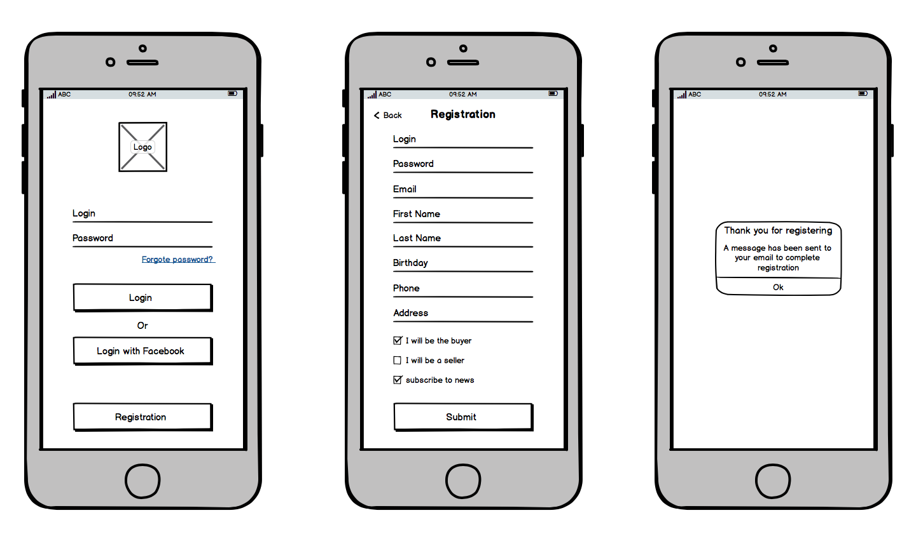
Design documents and prototypes
Design requirements are usually collected and documented using three main formats that morph into one another
Wireframes. Wireframes are low-fidelity graphic structures of a website or an app.
They help map different product pages with sections and interactive elements.

Slide 28
Mockups. Once wireframes are ready, they are turned into mockups, visual designs that convey the look and feel of the final product. Eventually, mockups can become the final design of the product.
Design prototypes. These documents contain visuals and allow for some interface interactions, like scrolling, clicking on links, or filling in forms.
Design prototypes can be built from scratch using HTML and CSS, but most UX teams use prototyping services like InVision.

Slide 29
Nonfunctional requirements examples
Nonfunctional requirements describe how a system must behave and establish constraints of its functionality. This type of requirements is also known as the system’s quality attributes.
Here, we’ll just briefly describe the most typical nonfunctional requirements.
Usability
Usability defines how difficult it will be for a user to learn and operate the system. Usability can be assessed from different points of view:
Efficiency of use: the average time it takes to accomplish a user’s goals, how many tasks a user can complete without any help, the number of transactions completed without errors, etc.
Intuitiveness: how simple it is to understand the interface, buttons, headings, etc.
Low perceived workload: how many attempts users need to accomplish a particular task.

Slide 30
Security
Example: Access permissions for the particular system information may only be changed by the system’s data administrator.
Reliability
Example: The database update process must roll back all related updates when any update fails.
Performance
Example: The front-page load time must be no more than 2 seconds for users that access the website using an LTE mobile connection.

Slide 31
Availability
Example: New module deployment mustn’t impact front page, product pages, and check out pages availability and mustn’t take longer than one hour. The rest of the pages that may experience problems must display a notification with a timer showing when the system is going to be up again.
Scalability
Example: The website attendance limit must be scalable enough to support 200,000 users at a time.

Slide 32
Best practices for documenting requirements
Creating documentation is an integral part of any software development project. Well-documented requirements ensure that stakeholders and developers are on the same page and also help define project scope and budget.
Requirements have to be clear and understandable.
Requirements have to be specific, accurate, and complete.
Requirements have to be testable.
Requirements have to be feasible and sensible.

